Slide 1



Project Title
PROJECT MEMBERS:
Jayaswati P 23ITR069
Jeyasanjay M 23ITR074
Megapranithaa M 23ITR096
Mythili M 23ITR106

Slide 2

To use a data structure like a hash table or trie to store and index document text.
To Implement algorithms for text preprocessing (tokenization, stemming, stop word removal).
To utilize string matching algorithms (e.g., Knuth-Morris-Pratt, Boyer-Moore) for finding plagiarized text segments.
To implement similarity measures like cosine similarity, Jaccard index, or n-gram matching.
To Use clustering algorithms (e.g., k-means, hierarchical) to group similar documents.
To Implement efficient data structures (e.g., suffix arrays, suffix trees) for pattern matching.
To Handle large document collections using techniques like shingling or locality-sensitive hashing.
To Provide a user interface for uploading documents and displaying plagiarism detection results.
To Integrate with external document sources or databases for comprehensive checking

Slide 3
Objectives
1)Detect Plagiarism in Textual Documents: Develop a system to identify plagiarized sections in text documents by comparing them against other documents in a database or external sources.
2)Improve Accuracy: Use advanced text preprocessing, similarity measures, and pattern matching algorithms to enhance detection accuracy.
3)Handle Large Datasets: Design the system to efficiently manage and process large document collections, ensuring scalability.
4)User-Friendly Interface: Provide an intuitive graphical user interface (GUI) using AWT for document upload and displaying results.
5)Integrate External Sources: Enable integration with external document databases to expand the system's checking capability.
3

Slide 4
Software Tools used
Java (for implementation and AWT for GUI)
Apache Lucene (for indexing and searching)
NLTK(Natural Language Toolkit for text preprocessing)
MySQL/PostgreSQL (for document storage and database management)
Google Scholar API/Turnitin API (for external source integration)
Jaccard/TF-IDF Libraries (for similarity measurement)
Apache Hadoop/Spark (for handling large datasets and parallel processing)
4

Slide 5
VARIOUS SOURCES OF PLAGIARISM INCLUDE:
Copying from Published Works: Using text, images, or ideas from books, articles, research papers, and other published materials without proper citation.
Internet Sources: Copying content from websites, blogs, online articles, or social media without acknowledgment.
Student Work: Reusing or copying from another student's assignment, essay, or project, either from the same institution or another one.
Self-Plagiarism: Reusing one’s own previous work (e.g., an assignment, paper, or article) without proper citation or permission.
Paraphrasing without Attribution: Rewording or summarizing someone else's ideas or text without giving credit.
Unattributed Translations: Translating text from one language to another without citing the original source.
Multimedia Plagiarism: Using images, videos, charts, or music from other creators without permission or acknowledgment.
Code Plagiarism: Copying source code from other programmers or repositories without giving credit (common in software development).

Slide 6
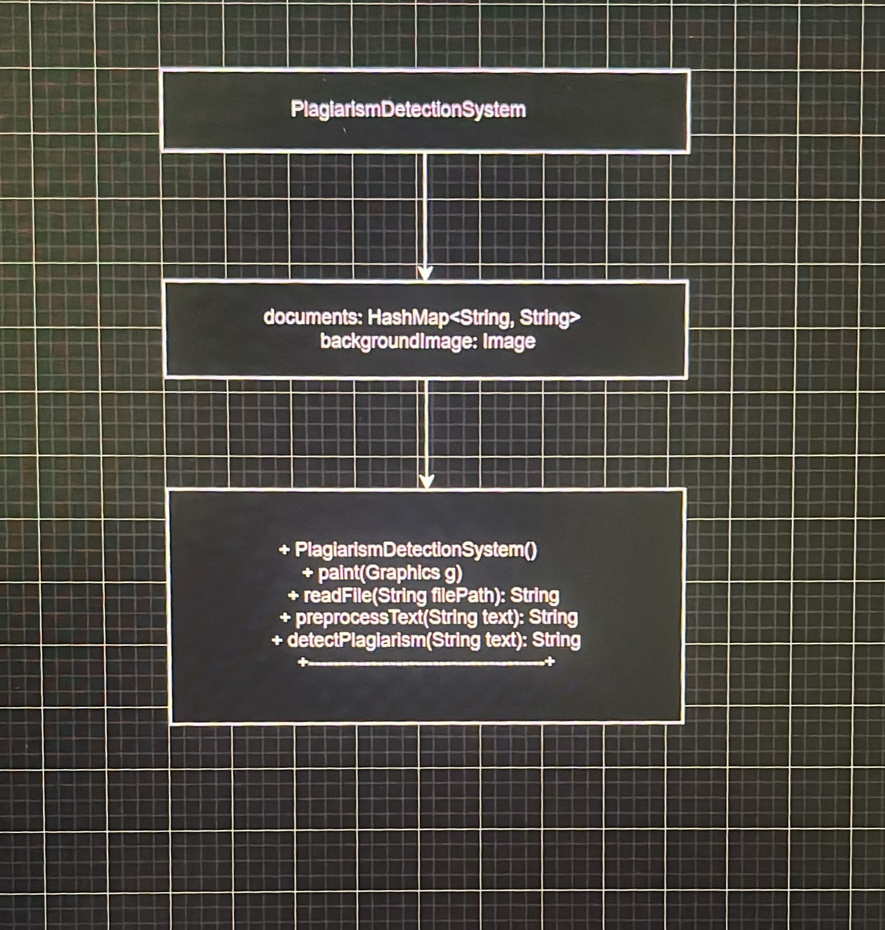
CLASS DIAGRAM

Slide 7
CODING
package PlagiarismCheckerUI;
import java.awt.*;
import java.awt.event.*;
import java.awt.image.BufferedImage;
import javax.imageio.ImageIO;
import java.net.URL;
import java.io.IOException;
import java.util.HashMap;
import java.util.Map;
public class PlagiarismChecker extends Frame implements ActionListener {
TextArea inputText;
Button checkButton;
Label resultLabel;
BufferedImage backgroundImage;
String referenceText = "When the big clock at the train station stopped, the leaves kept falling" +
" This blew my mind in high school, and I wasn’t the only one." + " Knowledge is power";
public PlagiarismChecker() {
setTitle("Plagiarism Checker");
setSize(500, 400);
setLayout(new GridBagLayout()); // Use GridBagLayout for better control over component positioning
GridBagConstraints gbc = new GridBagConstraints();
gbc.insets = new Insets(10, 10, 10, 10); // Add padding
inputText = new TextArea(10, 40); // Increased size
checkButton = new Button("Check for Plagiarism");
resultLabel = new Label("");
resultLabel.setFont(new Font("Arial", Font.BOLD, 16)); // Make result text bold and increase size
// Load the background image from the provided URL
try {
URL = new URL("http://www.bloggeron.net/wp-content/uploads/2020/11/Plagiarism-Checker.jpeg");
backgroundImage = ImageIO.read(url);
System.out.println("Image loaded successfully.");
}

Slide 8
catch (IOException e) {
System.err.println("Error loading image: " + e.getMessage()); }
checkButton.addActionListener(this);
checkButton.setBackground(Color.LIGHT_GRAY); // Button color
checkButton.setFont(new Font("Arial", Font.BOLD, 14)); // Button
// Center the components in the GridBagLayout
gbc.gridx = 0;
gbc.gridy = 0;
gbc.gridwidth = 1;
gbc.fill = GridBagConstraints.BOTH;
add(inputText, gbc);
gbc.gridx = 0;
gbc.gridy = 1;
gbc.fill = GridBagConstraints.HORIZONTAL;
add(checkButton, gbc);
gbc.gridx = 0;
gbc.gridy = 2;
gbc.fill = GridBagConstraints.HORIZONTAL;
add(resultLabel, gbc);
setVisible(true);
@Override
public void update(Graphics g) {
paint(g); // Override update to ensure proper redrawing
}
@Override
public void paint(Graphics g) {
// Draw the background image
if (backgroundImage != null) {
g.drawImage(backgroundImage, 0, 0, getWidth(), getHeight(), this);
} addWindowListener(new WindowAdapter() {
public void windowClosing(WindowEvent we) {
dispose();}}); }

Slide 9
@Override
public void update(Graphics g) {
paint(g); // Override update to ensure proper redrawing
}
@Override
public void paint(Graphics g) {
// Draw the background image
if (backgroundImage != null) {
g.drawImage(backgroundImage, 0, 0, getWidth(), getHeight(), this);
}
// Draw components after the background to ensure they appear on top
paintComponents(g);}
public void actionPerformed(ActionEvent e) {
String text = inputText.getText();
double plagiarismPercentage = checkForPlagiarism(text);
private double checkForPlagiarism(String text) {
Map<String, Integer> refWordCount = getWordFrequency(referenceText);
Map<String, Integer> inputWordCount = getWordFrequency(text);
double cosineSimilarity = calculateCosineSimilarity(refWordCount, inputWordCount);
return cosineSimilarity * 100; // Convert to percentage
}
private Map<String, Integer> getWordFrequency(String text) {
Map<String, Integer> wordCount = new HashMap<>();
String[] words = text.toLowerCase().replaceAll("[^a-zA-Z0-9 ]", "").split("\\s+");
for (String word : words) {
wordCount.put(word, wordCount.getOrDefault(word, 0) + 1);
}
return wordCount;
}

Slide 10
private double calculateCosineSimilarity(Map<String, Integer> refCount, Map<String, Integer> inputCount) {
double dotProduct = 0.0;
double refMagnitude = 0.0;
double inputMagnitude = 0.0;
for (String word : refCount.keySet()) {
int refFreq = refCount.get(word);
int inputFreq = inputCount.getOrDefault(word, 0);
dotProduct += refFreq * inputFreq;
refMagnitude += Math.pow(refFreq, 2);
}
for (int freq : inputCount.values()) {
inputMagnitude += Math.pow(freq, 2);
}
refMagnitude = Math.sqrt(refMagnitude);
refMagnitude = Math.sqrt(refMagnitude);
inputMagnitude = Math.sqrt(inputMagnitude);
if (refMagnitude == 0 || inputMagnitude == 0) {
return 0.0; // Avoid division by zero
}
return dotProduct / (refMagnitude * inputMagnitude);
}
public static void main(String[] args) {
new PlagiarismChecker();
}
}

Slide 11
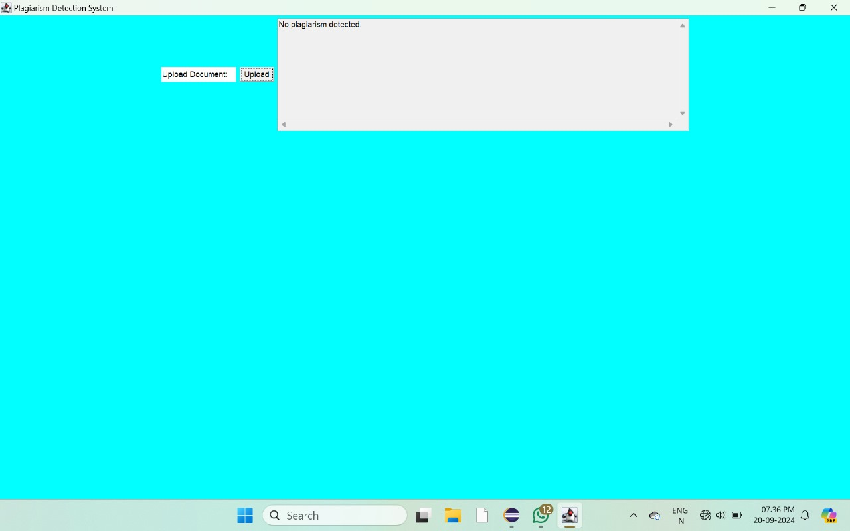
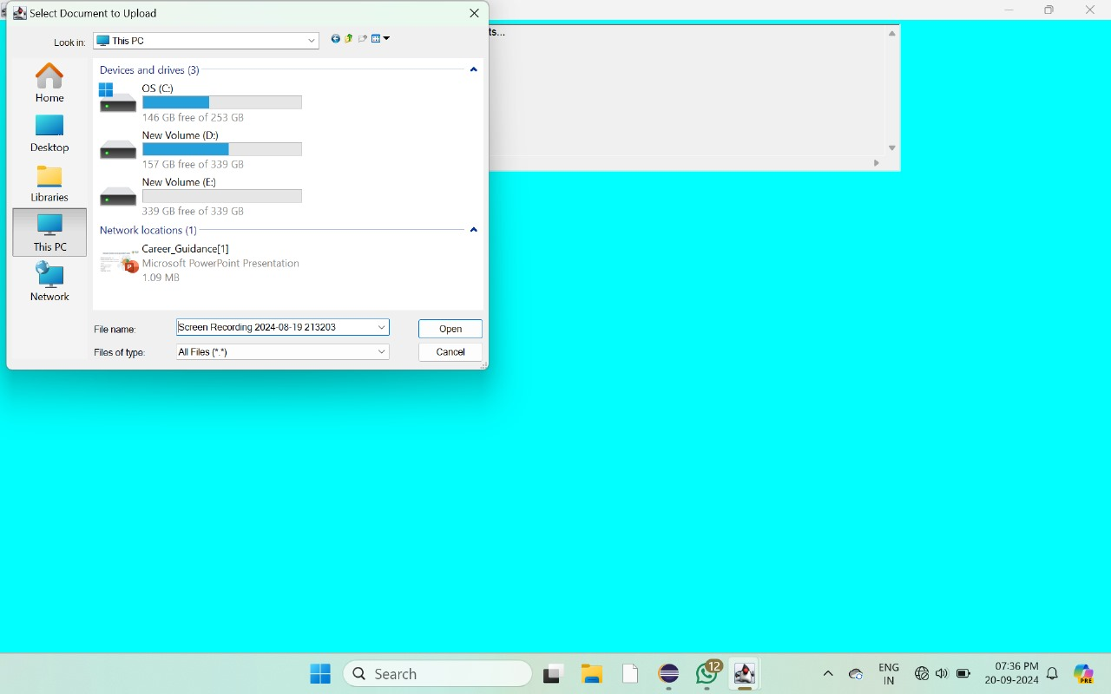
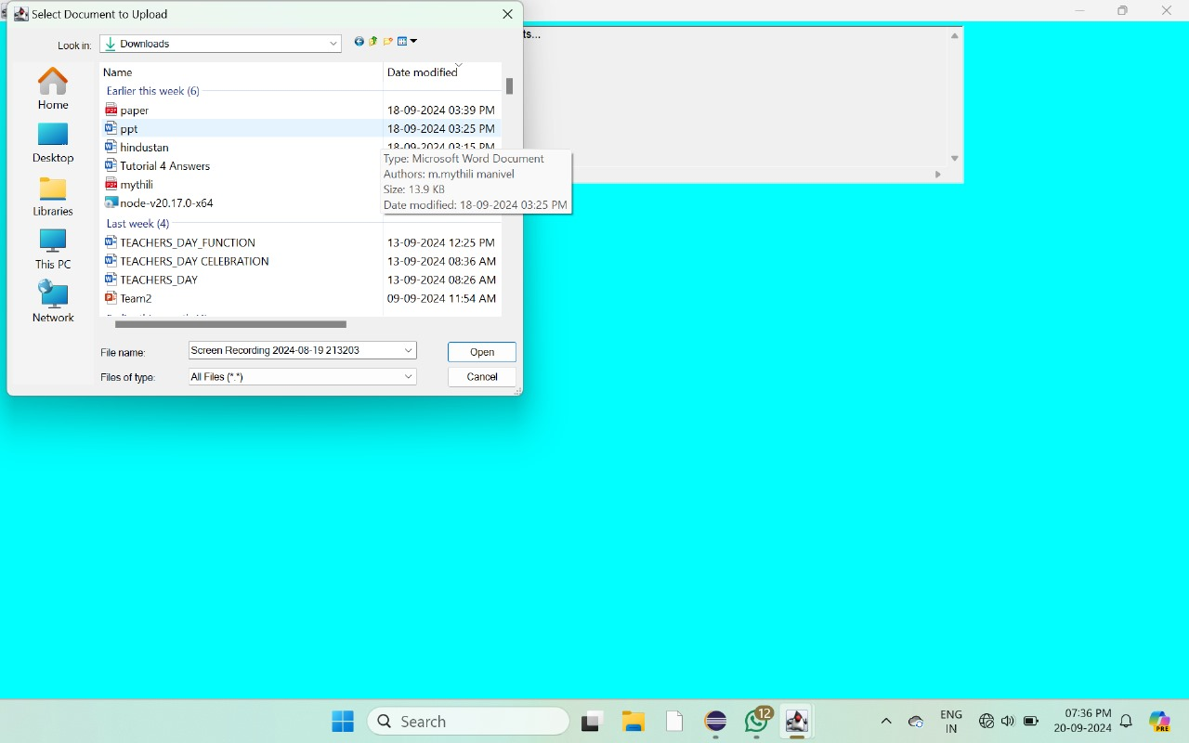

OUTPUT
11

Slide 12
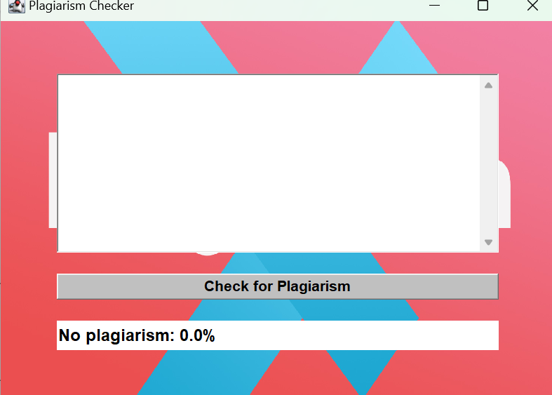

Slide 13
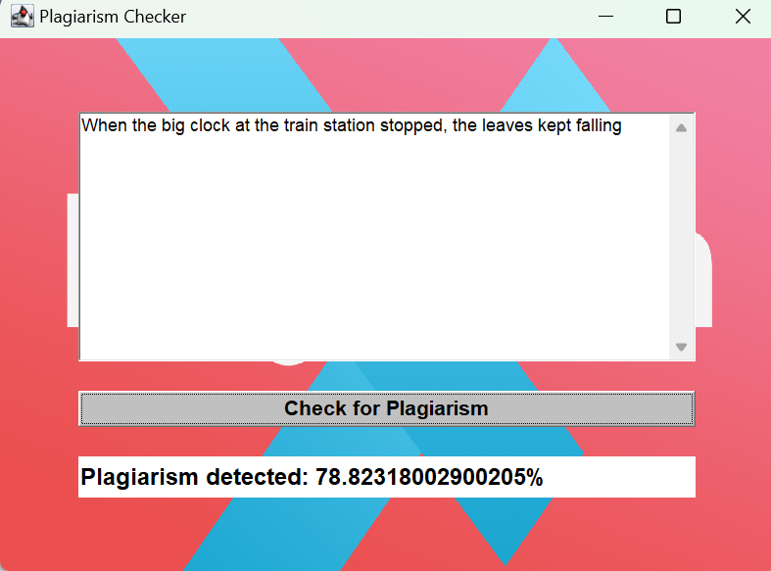

Slide 14
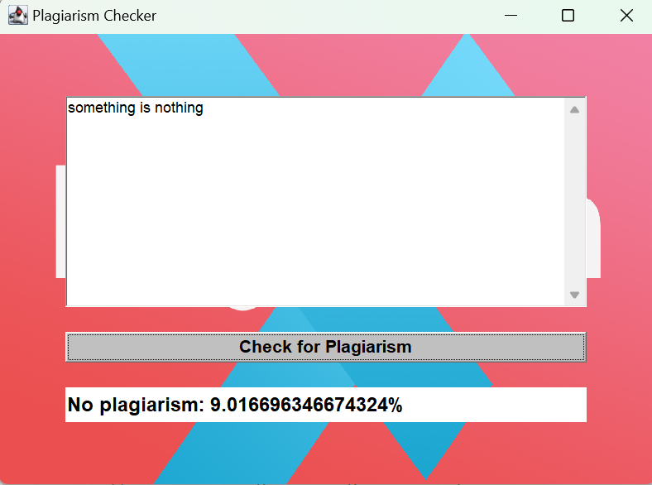

Slide 15
Thank you!

